Slide 1
Utilizing Roberta QA for JBNU Dataset
TEAM 4
201923196 - Pardinov Firdavs
201923250 - Kobilov Ilkhomjon
Advisor Professor : Tayara Hilal

Slide 2
Table of contents
01
02
03
04
What we did so far?
Application capabilities
Code review & Challenges faced
Presenting Live Demo of our App

Slide 3
01
What we did so far?
(AI)

Slide 4
(RoBERTa) =
Robustly Optimized BERT Pretraining Approach

Slide 5
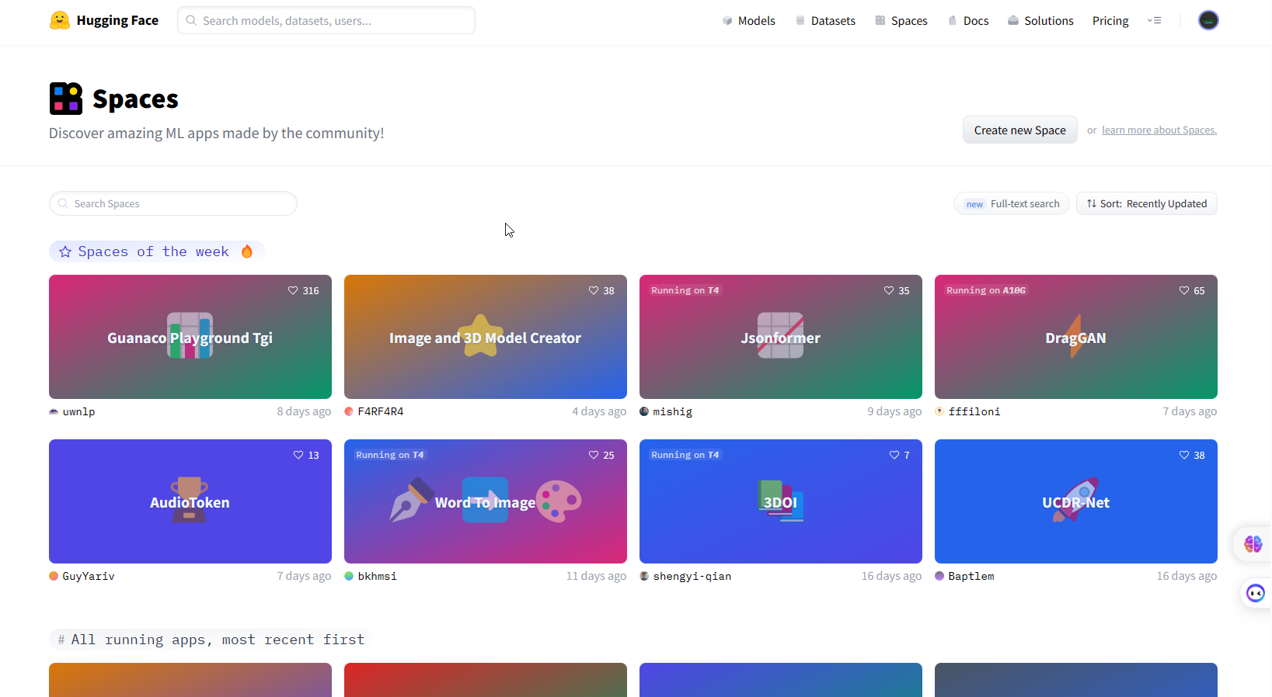
HuggingFace Spaces

Slide 6
What is Streamlit?
Easy-to-use API
Automatic widget generation
Data visualization
Deployment and sharing
Real-time updates

Slide 7
02
Application capabilities
(AI)

Slide 8
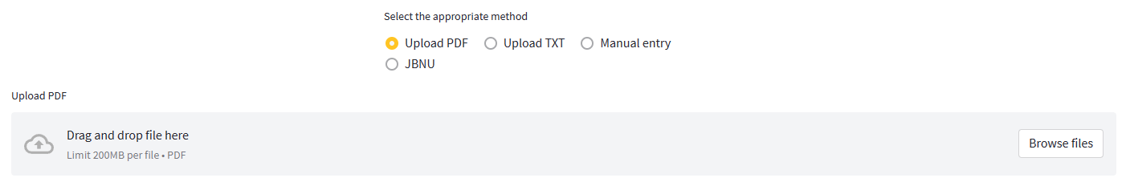
Upload PDF
Upload TXT
Roberta QA
Manual entry
JBNU

Slide 9
03
Challenges faced
(AI)

Slide 10
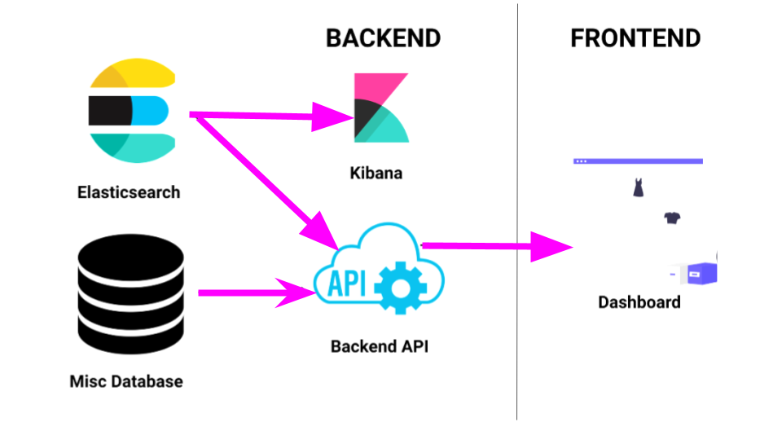

Slide 11
Challenges faced
(a) Speed
Most of the time, when the data is too big, it takes a long time to inference the model
(b) Data Scraping
In the JBNU website, the data is not organized for developers to scrape nor there is an API to request and get the data
(c) Data Preprocessing
Preparing the data in a squad format so that we can train the model

Slide 12
04
Live Demo

Slide 13
Thank you

Slide 14
Resources
Links
Chatbot Team4
Streamlit • A faster way to build and share data apps
Haystack | Haystack (deepset.ai)

